Slide 1
Quarterly Operating Limits Education Session (Application)
Riley Smith and Carter Lassetter
4/29/26

Slide 2
QOL Overview

Slide 3
Purpose of QOL
Give projects that are shovel ready and have a LOIS amount from DISIS/CPP to increase service before upgrades.
Allow for the study of multiple LOSIS projects in the same vein as the Annual Interim but on a quarterly basis.
More generation online faster.

Slide 4
LOIS (Limited Operation Interconnection Service) Value Types
DISIS (Definitive Interconnection System Impact Study)
LOIS determined for all projects within DISIS cluster. Can differ when LOSIS is performed
CPP (Consolidated Planning Process)
Same as DISIS
LOSIS (Limited Operation System Impact Study)
A Special Study that re-evaluates the LOIS amount determined through DISIS/CPP for an individual Generator Interconnection Request

Slide 5
QOL Requirements
QOL will be a quarterly study
GIR Participation: Generator Interconnection Requests (GIRs) can choose to participate in all four quarterly studies or maintain their existing DISIS/LOISIS limits.
Opt-In Commitment: Once a GIR opts into the QOL study, their participation is required for that calendar year or until the study's constraints are lifted.
GIR Choice: GIRs who prefer to be limited to the results of the DISIS/CPP for the entire year may choose not to participate in the quarterly studies for that year.

Slide 6
Applicability and Timeline

Slide 7
Applicability
The GIR has requested inclusion in the QOL study and will be in commercial operation ≥ 60% of the QOL study horizon
The GIR has an effective Generator Interconnection Agreement (GIA) not on suspension
The GIR’s associated Contingent Facilities or Network Upgrades is not expected to be in-service by the request’s COD
The upgrades are referenced in the subject GIR’s GIA (e.g. Contingent Facility, Shared Network Upgrade)
An SPP upgrade has been assigned to address the most limiting element related to the GIR’s current LOIS amount
An SPP upgrade has been issued for a new outlet from the GIR’s Point of Interconnection (POI)

Slide 8
QOL Timeline
Open Window: May 4th – May 31st
Data Validation: June 1st – June 30th
Analysis: July 1st (1.5 to 2 months)
QOL Fall Season Posting: September 15th

Slide 9
0 days
20 days
22 days
55 days
12 days
43 days
2026
2026
Today
QOL Timeline
May 4 - May 31
Open Window
Jun 1 - Jun 30
Data Validation
Jul 1 - Sep 15
Analysis
Sep 16 - Oct 1
Update Market Registration
Oct 1 - Nov 30
Q3 2026
May
Jun
Jul
Aug
Sep
Oct
Nov
Sep 15
Fall Season Posting

Slide 10
QOL Study Methodology

Slide 11

Purpose
Provide stakeholders insight on how the QOL study will be performed.
Highlight rationale of study mechanisms.
Discuss implications of study results.

Slide 12
QOL Study Models Used & Dispatch
SPP will leverage the most relevant and available study models for steady state and stability analyses for the appropriate study season.
Steady State: HVER/LVER/NR Model dispatch consistent with BPM 7250 Section 4.2.1.
Stability/Short Circuit: Model dispatch consistent with BPM 7250 4.3.1.1.
Operational Dates | Steady State Model | Stability/Short Circuit Model
April 1 – May 31 | Spring model (or equivalent) | Spring model (or equivalent)
June 1 – September 30 | Summer Peak | Summer Peak
October 1 – November 30 | Fall model (or equivalent) | Fall model (or equivalent)
December 1 – March 31 | Winter Peak | Winter Peak

Slide 13

QOL Study Models Key Considerations
Load within the study models will remain untouched.
Legacy/Non-Legacy generation remains at modeled levels, except when used as a sink.
Planned outages of transmission spanning ≥ 60% for study quarter will be modeled offline.
Retired or suspended generation will be modeled offline for study quarter.

Slide 14
QOL Study Projects
Projects opting into QOL study will be modeled as Current Queue (CQ) generation at 100% of their requested interconnection level.
Projects not opting into the QOL study but having active and incomplete upgrades will be included at their latest granted LOIS levels.
Prior Queued (PQ): Projects in the queue, not modeled in cases.
Prior Queued (PQE): PQ projects near CQ projects to be dispatched more aggressively.
 | QOL Study Project (CQ) | Eligible QOL Study Project Not Electing for Study (PQ) | PQE Projects (Consistent with BPM 7250 Language) | Other Non-Modeled PQ Projects
Dispatch Level | 100% | Latest granted LOIS Level | Latest granted LOIS Level | FBD Table
Re-disaptched to Solve Identified Relevant Violations | Yes | No | No | No
Sinking Methodology When Dispatching | Same as BPM 7250 Sections 4.2.1 and 4.3.1.1

Slide 15
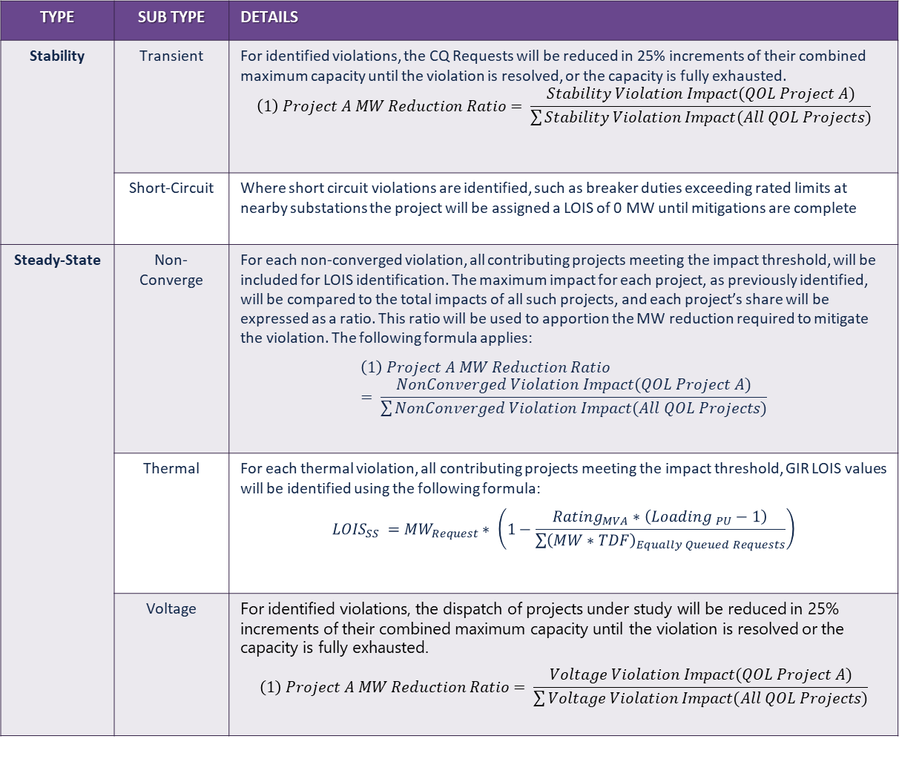
Analysis
Type | Sub Type | Details
Stability | Transient | For identified violations, the CQ Requests will be reduced in 25% increments of their combined maximum capacity until the violation is resolved, or the capacity is fully exhausted. $$\left(1\right) Project A MW Reduction Ratio= \frac{Stability Violation Impact(QOL Project A)}{\sum{Stability Violation Impact(All QOL Projects)}}$$
 | Short-Circuit | Where short circuit violations are identified, such as breaker duties exceeding rated limits at nearby substations the project will be assigned a LOIS of 0 MW until mitigations are complete
Steady-State | Non-Converge | For each non-converged violation, all contributing projects meeting the impact threshold, will be included for LOIS identification. The maximum impact for each project, as previously identified, will be compared to the total impacts of all such projects, and each project’s share will be expressed as a ratio. This ratio will be used to apportion the MW reduction required to mitigate the violation. The following formula applies: $$\left(1\right) Project A MW Reduction Ratio= \frac{NonConverged Violation Impact(QOL Project A)}{\sum{NonConverged Violation Impact(All QOL Projects)}}$$
 | Thermal | For each thermal violation, all contributing projects meeting the impact threshold, GIR LOIS values will be identified using the following formula: $${LOIS}_{SS} ={MW}_{Request}∗ \left(1−\frac{{Rating}_{MVA}∗\left({Loading }_{PU}−1\right)}{\sum{{\left(MW∗TDF\right)}_{Equally Queued Requests}}}\right)$$
 | Voltage | For identified violations, the dispatch of projects under study will be reduced in 25% increments of their combined maximum capacity until the violation is resolved or the capacity is fully exhausted. $$\left(1\right) Project A MW Reduction Ratio= \frac{Voltage Violation Impact(QOL Project A)}{\sum{Voltage Violation Impact(All QOL Projects)}}$$
Analysis performed by identifying violations consistent with BPM 7250’s Sections 4.2.2.1, 4.2.2.2, and 4.2.2.3.
LOIS calculations are performed on a per violation basis when referencing table to the right.
Only projects considered CQ for the QOL study will be re-dispatched for identified LOIS levels.

Slide 16
Granting LOIS – Process Flow
Identify Impacted Projects
Apply Generation Reduction for Impacted Projects
Yes
Violation Identified?
Start QOL Evaluation
Violation Mitigated?
Yes
No
No
No Action Needed
Project Final LOIS = Minimum Across All Violations
LOIS Value Identified for Violation

Slide 17
LOIS Level Calculation Example
Project A
(100 MW)
Project B
(200 MW)
Project C
(300 MW)
For each identified violation, projects meeting criteria will be tagged.
For each violation a project is tagged to, a limit is identified.
The minimum level across all violations for a project is their end LOIS value.
Violation 1
Violation 1
Violation 6
Violation 2
Violation 4
Violation 7
Violation 3
Violation 5
 | Project Specific Violation Limits (MW) |  |  |  |  |  |  | End Project LOIS Level
 | Violation 1 | Violation 2 | Violation 3 | Violation 4 | Violation 5 | Violation 6 | Violation 7
Project A | 75 | 50 | 85 | N/A | N/A | N/A | N/A | 50
Project B | 150 | N/A | N/A | 125 | 175 | N/A | N/A | 125
Project C | N/A | N/A | N/A | N/A | N/A | 250 | 225 | 225
A project’s LOIS equals the lowest level across all its violations.

Slide 18

Summary/Outcomes
The QOL Study establishes updated LOIS levels for all participating customers.
Updated LOIS values supersede previously identified limits for the applicable quarter.
Participating customers receive refreshed LOIS determinations on a quarterly basis.

Slide 19
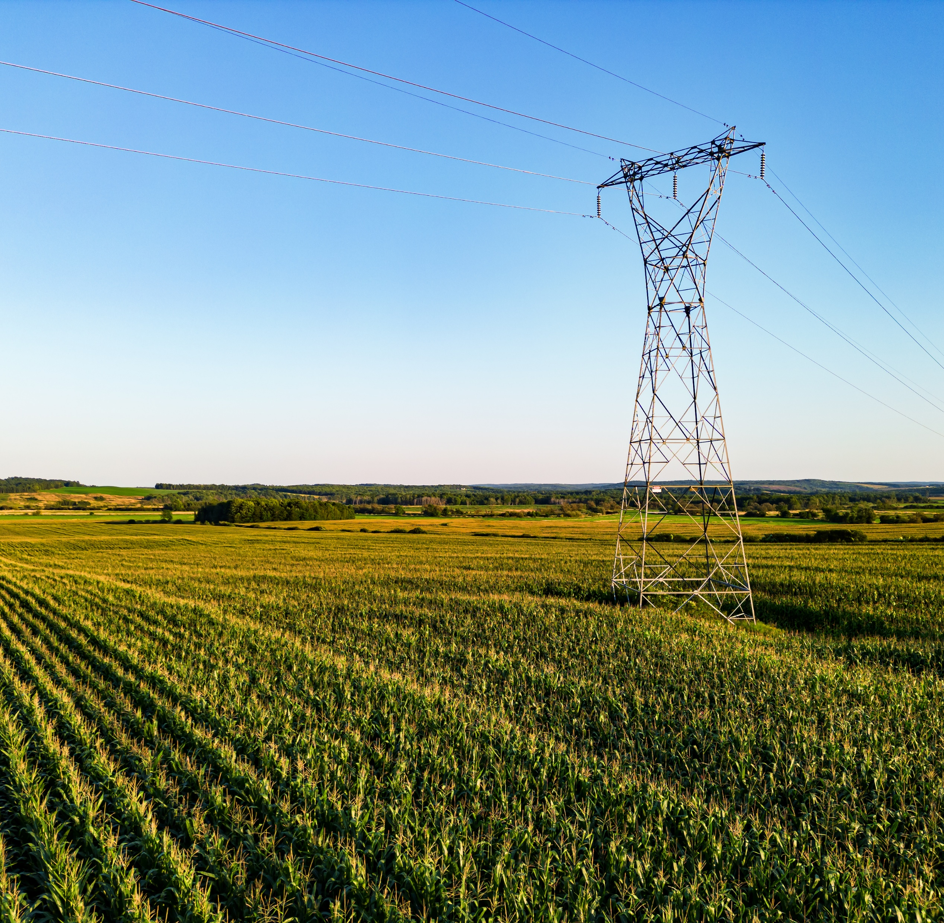
Contact Slide
Riley Smith: Rsmith@spp.org
or
Carter Lassetter: classetter@epeconsulting.com

Slide 20
Appendix

Slide 21
Definitions
Term | Definition
Current-Queue Request | An Interconnection Request being evaluated in the current study.
Definitive Interconnection System Impact Study | an engineering study that evaluates the impact of the proposed interconnection on the safety and reliability of Transmission System and, if applicable, an Affected System. The study shall identify and detail the system impacts that would result if the Generating Facility were interconnected without project modifications or system modifications, or that may be caused by the withdrawal or addition of an Interconnection Request, or to study potential impacts, including but not limited to those identified in the Scoping Meeting as described in the Generator Interconnection Procedures. The Definitive Interconnection System Impact Study is conducted in two phases.
Electric Storage Resource | A resource capable of receiving electric energy and storing it for later injection of electric energy to the grid. A resource that is either (1) physically incapable of injecting electric energy to the Transmission System due to its design or configuration or (2) contractually barred from injecting electric energy to the Transmission System is excluded from this definition.
Electrically Equivalent | A relationship between Points of Interconnection (POI) that are (1) at the same substation and nominal voltage level, (2) on the same branch or on a collection of in-series two-terminal branches and associated buses and facilities , or (3) on the same radial branch and associated facilities.
Group | The interconnection requests are grouped into five (5) active regions based on geographical and electrical impacts.
High Variable Energy Resource | high variable energy resource
Megawatt | A measurement unit of the instantaneous demand for Energy.

Slide 22
Definitions
Term | Definition
Modification of Delivery Points | In the event that a Network Customer desires to modify an existing delivery point in a manner requiring action by a Transmission Owner, it shall initiate such modification by notifying the Transmission Provider and Transmission Owner of this desired change. Such notification, processing and cost recovery of all facilities associated with such request shall be governed by the provisions of Section 31.2a. above and Attachment AQ hereto.
Network Load | The load that a Network Customer designates for Network Integration Transmission Service under Part III of the Tariff. The Network Customer's Network Load shall include all load served by the output of any Network Resources designated by the Network Customer. A Network Customer may elect to designate less than its total load as Network Load but may not designate only part of the load at a discrete Point of Delivery. Where an Eligible Customer has elected not to designate a particular load at discrete points of delivery as Network Load, the Eligible Customer is responsible for making separate arrangements under Part II of the Tariff for any Point-To-Point Transmission Service that may be necessary for such non-designated load.
New Delivery Point | When a Network Customer requests a new delivery point to be built to serve its load such notification and processing of the request shall be governed by the provisions of Attachment AQ.
Non-Legacy | ITP Non-Legacy Request (have been studied in a GI process and are in the ITP models)
Point of Interconnection | shall mean the point, as set forth in Appendix A to the Generator Interconnection Agreement or Interim Generator Interconnection Agreement, as applicable, where the Interconnection Facilities connect to the Transmission System.
Prior-Queued Request | An Interconnection Request that has neither been withdrawn nor terminated, that has a higher queue priority (was entered in an earlier DISIS Queue Cluster Window) than Current-Queue Requests and is not an ITP Generator.
Transfer Distribution Factor | The impact of an interchange transaction or power injection at a bus on a given flowgate; the measure of responsiveness or change in electrical loading on system facilities due to a change in electric power transfer from one area to another expressed in as a percentage (up to 100%) of the change in power transfer.

Slide 23
Acronyms
Acronym | Name
BOD | Board of Directors
COD | Commercial Operation Date
CQ Request | Current-Queue Request
DISIS | Definitive Interconnection System Impact Study
EE | Electrically Equivalent
ESR | Electric Storage Resource
ESR-LA | Electric Storage Resource Load Assessment
GIAG | Generation Interconnection Advisory Group
HVER | High Variable Energy Resource
MOPC | Markets and Operations Policy Committee
MW | Megawatt
NL | Non-Legacy
ORWG | Operating Reliability Working Group
POI | Point of Interconnection
PQ | Prior-Queue
PTDF | Power Transfer Distribution Factor
QOL | Quarterly Operating Limit
RTWG | Regional Tariff Working Group
TDF | Transfer Distribution Factor
TWG | Transmission Working Group

